Slide 1
Semantic Problems of Text Mining

Slide 2
Text Representation
Text Representation is the key component of text-based applications.
Traditional text representation model
Bag of words
N-grams
Suffix tree model

Slide 3
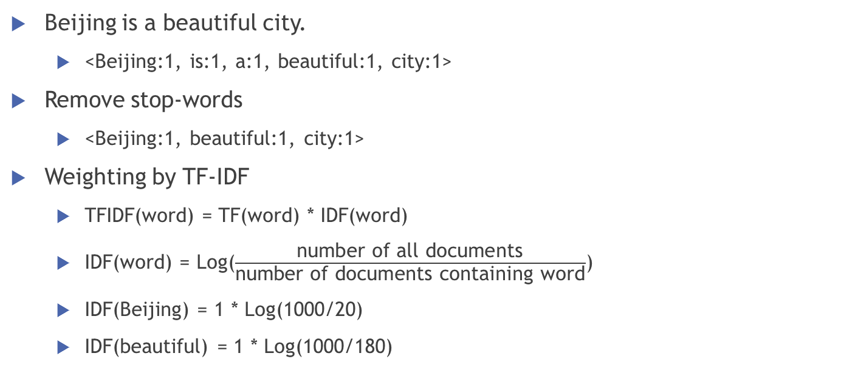
Bag-of-Words(BOW) Model
Beijing is a beautiful city.
<Beijing:1, is:1, a:1, beautiful:1, city:1>
Remove stop-words
<Beijing:1, beautiful:1, city:1>
Weighting by TF-IDF
TFIDF(word) = TF(word) * IDF(word)
IDF(word) = Log($\frac{\text{number} \text{of} \text{all} \text{documents}}{\text{number} \text{of} \text{documents} \text{containing} \text{word}}$)
IDF(Beijing) = 1 * Log(1000/20)
IDF(beautiful) = 1 * Log(1000/180)

Slide 4
N-grams Model
Beijing is a beautiful city.
N=3
(“Beijing is a”: 1, “is a beautiful”: 1, “a beautiful city: 1”
“Beijing is” : 1, “is a”: 1, “a beautiful”: 1. “beautiful city”: 1
Beijing: 1, is : 1, a: 1, beautiful: 1, city: 1)
Remove stop-words
Weighting by TF-IDF

Slide 5
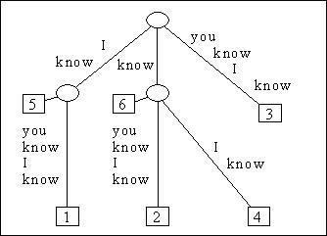
Suffix Tree Model
Build a Tree using all the suffix
I know you know I know
know you know I know
you know I know
know I know
I know
know

Slide 6
Limitation of traditional text representation models
Only literal meanings
Beijing, Peking
Adding Semantic to text
Implicit Knowledge
Explicit Knowledge
Implicit Knowledge
Beijing and Peking are of the same topic
Explicit Knowledge
Beijing -> ENTITY_Beijing_(capital of China)
Peking -> ENTITY_Beijing_(capital of China)

Slide 7
Implicit Knowledge
Goal
Clustering
Grouping similar words / n-grams to clusters
Simple Motivation
Co-occurrence
Topic Model
Learning implicit knowledge

Slide 8
Topic Model
topic model is a type of statistical model for discovering the abstract "topics" that occur in a collection of documents
Intuitively, given that a document is about a particular topic, one would expect particular words to appear in the document more or less frequently.
Topic A: travel (trip, flight, historical site)
Topic B: political (republican, election)
Latent Dirichlet Allocation (LDA)
A common used topic model

Slide 9


LDA
Latent Dirichlet Allocation does not consider word order.
The matrices and govern the word emission conditioned on topic, and topic emission conditioned on document, respectively.
Where t is the word index within the corpus, i is the word index in the dictionary, k is the topic index, and d is the document index.

Slide 10

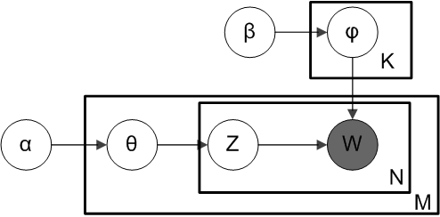
LDA
Therefore, the joint probability of the corpus and the set of latent topics is

Slide 11


LDA
Inference
Give topic number
Word distribution for each topic
Topic distribution for each document
Gibbs Sampling

Slide 12
Applications of LDA
Similarity of documents
Word distribution for each topic
Revise: topic distribution over each word
Topic A: travel (trip, flight, historical site)
Topic B: political (republican, election)
D1: (A: 0.8, B:0.2), D2: (A:0.2, B: 0.8), D3: (A: 0.75, B:0.25)
Query expansion
Query: Beijing
Expansion: Peking, Capital
…

Slide 13
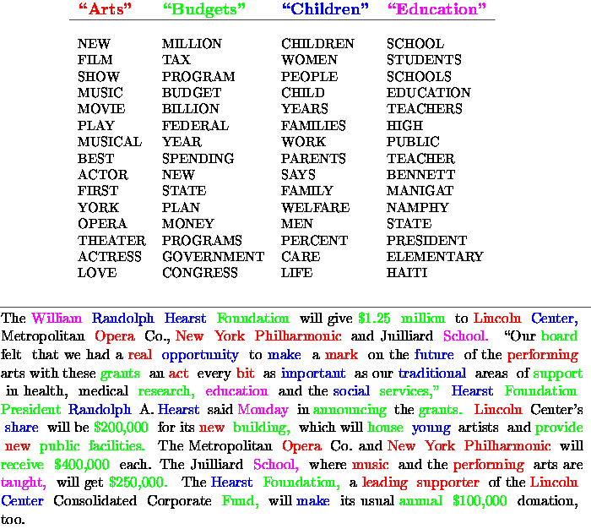

Slide 14
Explicit Knowledge
Goal:
Classification
Mapping literal words to entities in the knowledge base
Common knowledge base
WordNet
Wikipedia

Slide 15
WordNet
WordNet is a lexical database for the English language.
groups English words into sets of synonyms called synsets
provides short, general definitions
records the various semantic relations between these synonym sets.
Advantages
Authority (created by expert)
Disadvantage
Low coverage

Slide 16
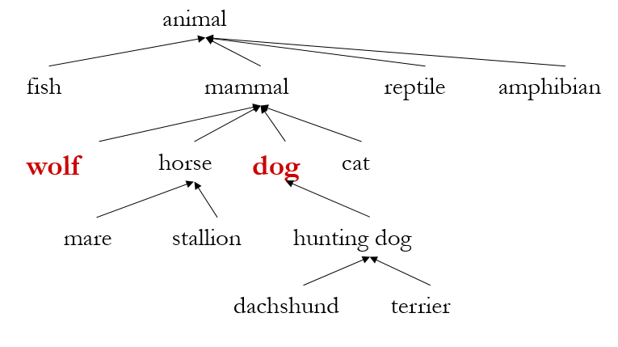
Tree structure of WordNet

Slide 17
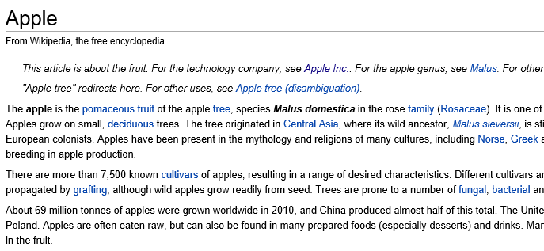
Wikipedia
Wikipedia is currently the largest knowledge repository on the Web
English version has 600+ million entities in over one million articles
Each page is an entity, corresponding with a description article

Slide 18
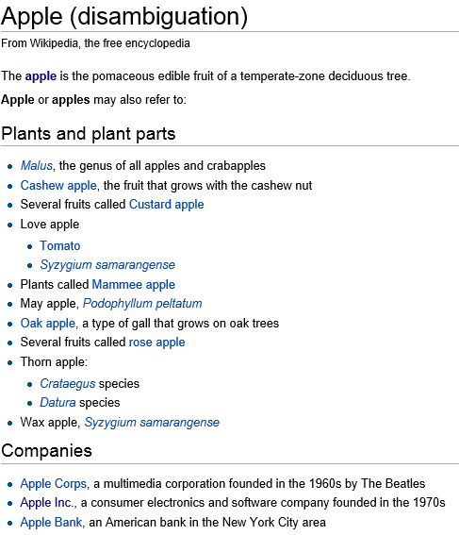
Disambiguation Page

Slide 19
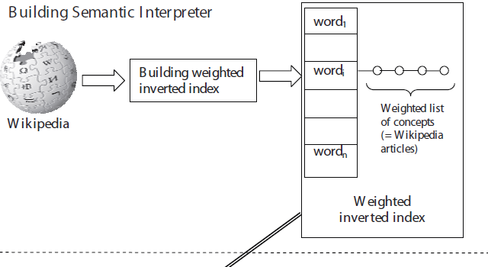
Explicit Semantic Analysis
Mapping words to Wikipedia entities

Slide 20
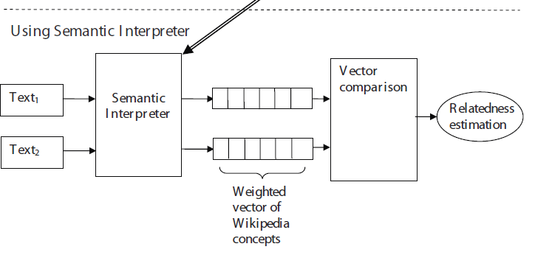
Explicit Semantic Analysis (cont.)
Calculating Similarity of texts

Slide 21
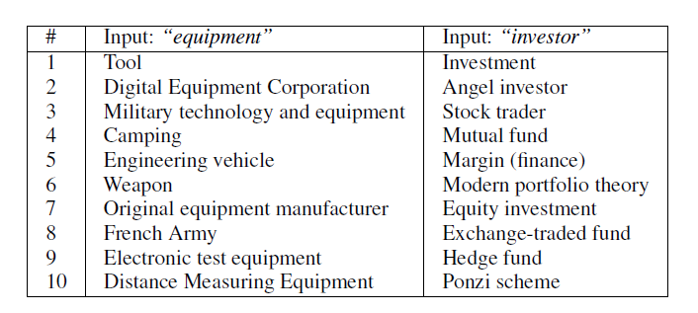
Results of word mapping

Slide 22
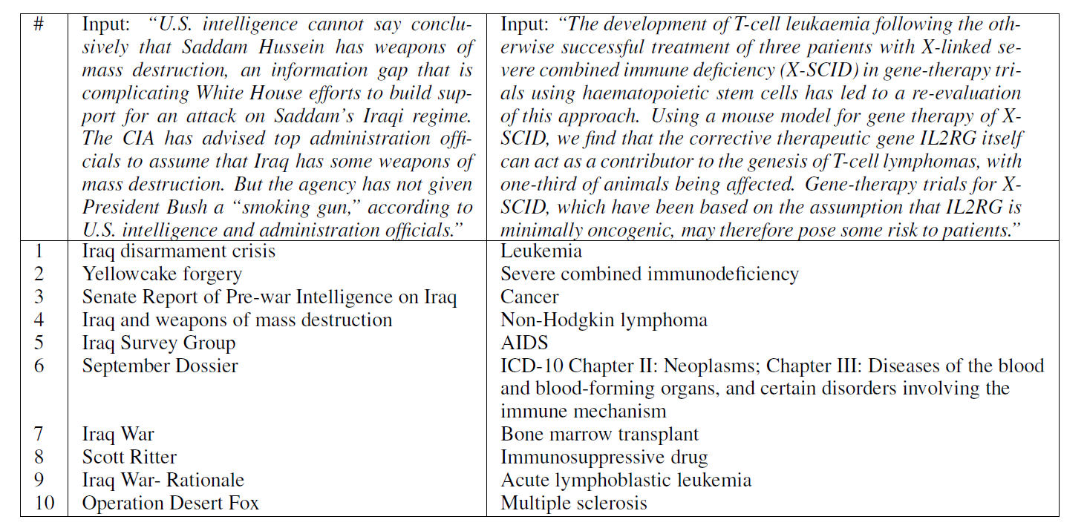
Results of text mapping

Slide 23
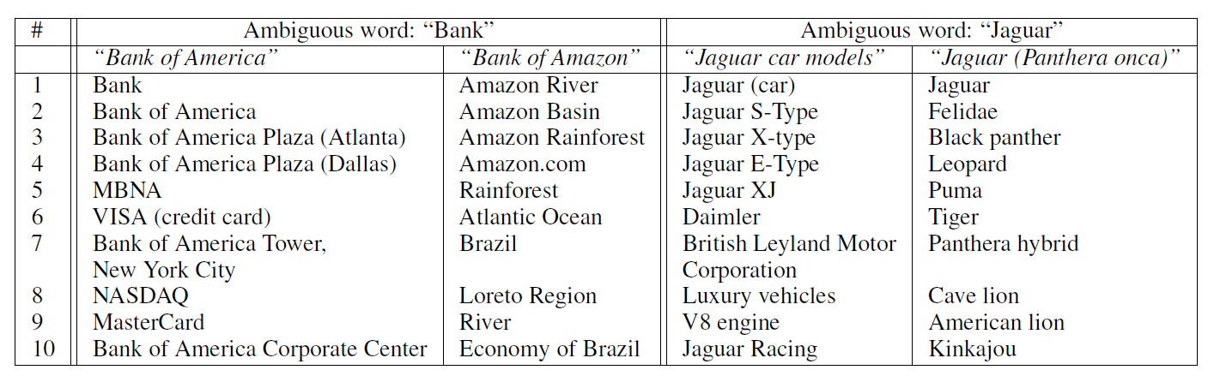
Results of Ambiguous words

Slide 24
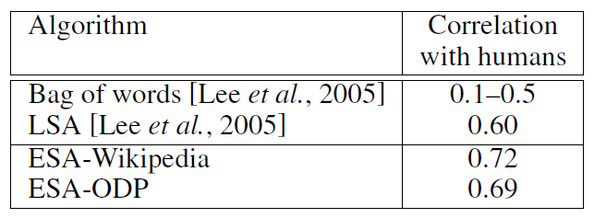
Results of Text Relatedness
LSA: Latent semantic analysis
ODP: Open Directory Project

Slide 25
Sequential Tagging Problems
Problems in machine learning
Clustering / Classification
Sequential Tagging
Regression
Algorithms of sequential tagging
HMM (Hidden Markov Model)
CRF (Conditional Random Fields)

Slide 26
Examples of Tagging Problems
Part-of-Speech (POS) tagging
Input: the dog saw a cat
Output: D N V D N
Segmentation
Input: the dog saw a cat
Output: 0 1 0 1 1
Named Entity Recognition (NER)
Input: Michael Jordan is a leading reseacher in machine learning.
Output: 0 0 1 1 1 1 1 0 0

Slide 27
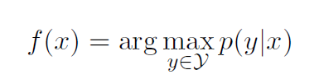
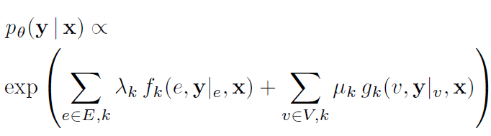
HMM vs. CRF
HMM
Generative Model
CRF
Discriminative Model

Slide 28
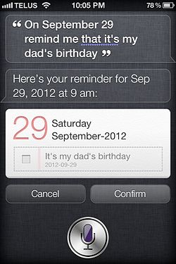
Application
Siri – intelligent personal assistant
Speech recognition
Task understanding
Slot Filling

Slide 29
Task Understanding
Classification
Flight Tickets
Restaurant
Reminder
On September 29 remind me that it’s my dad’s birthday
Text representation
Text classification / clustering
Task understanding result: Reminder

Slide 30
Slot Filling
Task: Reminder
Slots
Date
Event
Sequential Tagging
Input: On September 29 remind me that it’s my dad’s birthday
Output: 0 D D 0 0 0 E E E E
Slot filling result
Date: September 29
Event: it’s my dad’s birthday

Slide 31
Thanks for your attentions.^_^

